Slide 1
MAR 580: Advanced Population Modeling for Management of Living Marine Resources
Lecture 9
Multi-State Models
(Acknowledgments: T.S. Geisel)
10 November 2015

Slide 2
Where Are We?
Questions from last week’s lecture or lab?
Multi-Sate Models (Cooch & White, MARK Chapter 8)

Slide 3
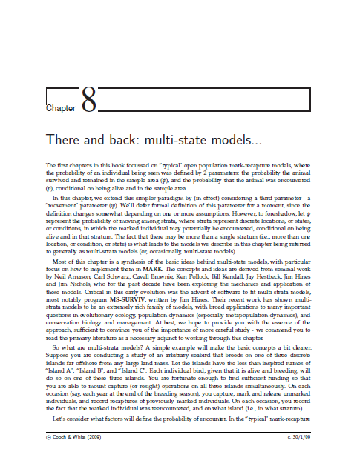
Today’s Outline
Lecture
Separating survival and movement
A worked example: cost of breeding analysis
A simple metapopulation model
A more complex analysis - recruitment rate
Estimation problems
Multi-strata models as a unifying framework
Lab 8 – Bird migration

Slide 4
Multi-State Mark-Recapture Models
In the mark-recapture model, the probability of an individual being observed was defined by two parameters:
probability the animal survived and remained in the sample area, φ (phi)
probability that the animal was encountered (p)
Multi-state models considering a third parameter
Ψ (psi, ‘sigh’): probability of moving among states

Slide 5
… not to be confused with
“Multi-state models”:
allow for transitions among states in a population process,
assume a deterministic process for transitions among states with observation error.
“State-space models”:
use state variables to describe a system by a set of first-order differential or difference equations,
usually accounting for observation error and process error.

Slide 6
Markov Transition
The transition probabilities (i.e., making the transition from live to dead, or from one area to another) represent a Markov process (the probability of transition from time i to i+1 is dependent only on the state at time i).
φ_{i}^{rs}: probability that an animal alive in state r at time i is alive and in state s at time i+1 (probability of both surviving and transitioning among states)

Slide 7
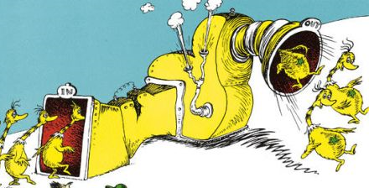

Case Study: Island Birds
A seabird breeds on one of three islands (A, B, C).
Each year at the end of the breeding season, a sample of birds is given an island-specific mark, and the number of previously marked birds is recorded.
Recapturing a bird on Island B that was tagged on Island B is conditional on
surviving to the next occasion, and
not moving to another island.

Slide 8
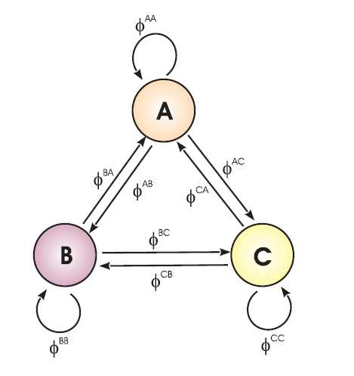
Markov Movement
φ_{i}^{rs}: probability that an animal alive in state r at time i is alive and in state s at time i+1 (probability of both surviving and moving)

Slide 9
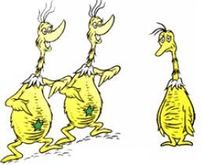
Multi-State Encounter Histories

Slide 10
Multi-State Encounter Probabilities
Encounter history AAB:
released on island A
Survived, stayed in island A and was recaptured
Survived and moved to island B and was recaptured on island B:

Slide 11
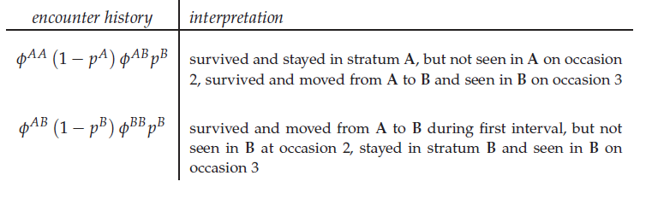
Multi-State Encounter Probabilities
Encounter history A0B has two ‘probability paths:’

Slide 12
Separating Survival & Movement
To partition survival and movement, we need to assume an order of events (e.g., that movement occurs after survival; or survival depends on the old area, not the new area):

Slide 13
Multi-State Models
Strata can be areas, and multi-state models can quantify transition between areas (i.e., movement).
States can be any state (e.g., maturity or breeding state).
Example: Cost of Breeding – fitness is the product of survival and fecundity, but there are tradeoffs between energetic investments.

Slide 14

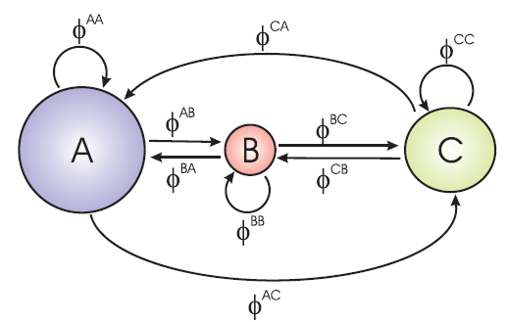
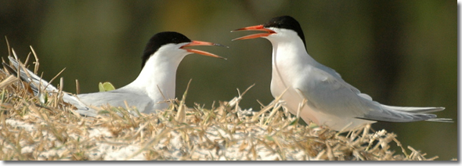
Metapopulation Model
Roseate terns breed on 3 islands of different size and habitat with varying distances between them:

Slide 15
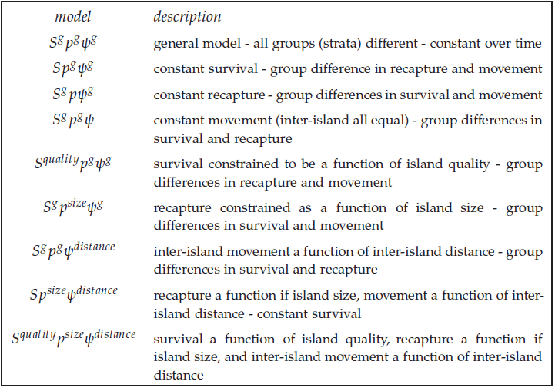
Metapopulation Models

Slide 16
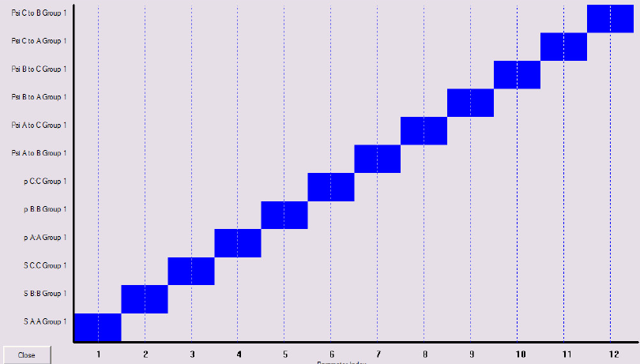
General Metapopulation Model

Slide 17
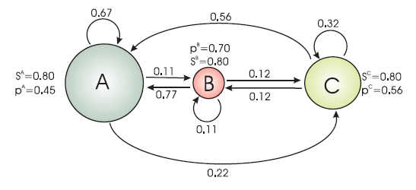
General Model Results

Slide 18
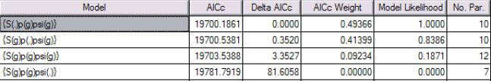
Alternative Models
Constant survival among islands and island-specific capture and movement probabilities is the ‘best model’.

Slide 19
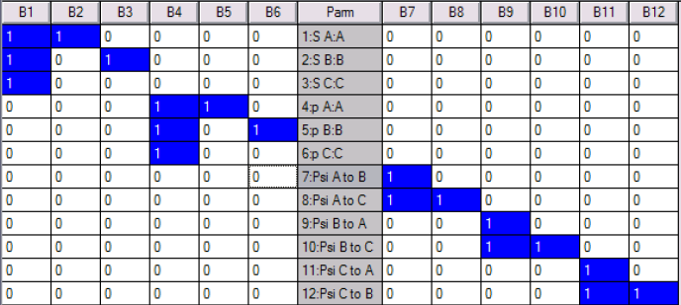
Design Matrix

Slide 20
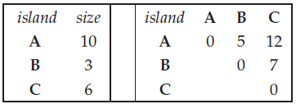
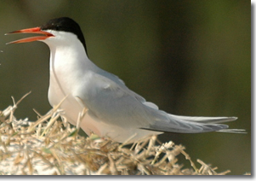
Size and Distance Covariates
Island size and distance among islands are used to inform transition probabilities:

Slide 21
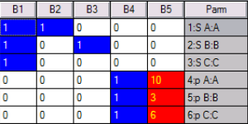
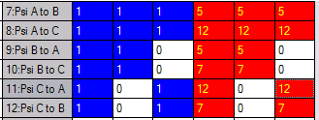
Modified Design Matrix

Slide 22
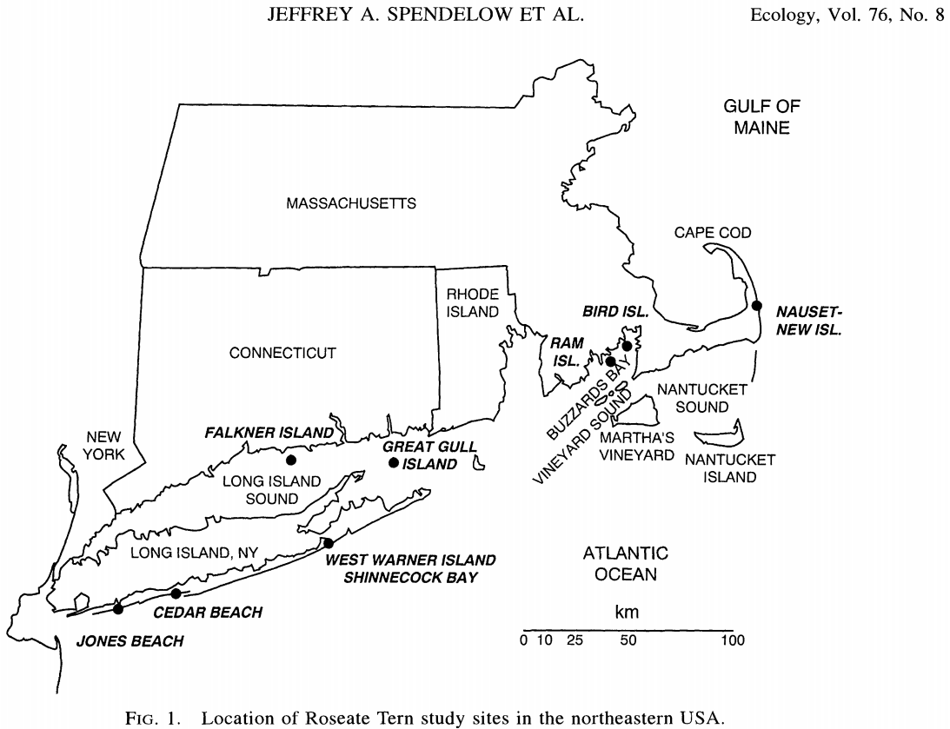

Slide 23
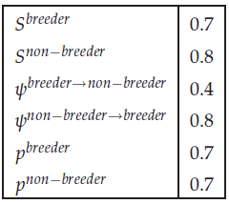
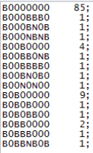

The Cost of Breeding
Deer example with lower survival of breeders than non-breeders, and transitions from non-breeder to breeder and from breeder to non-breeder:

Slide 24
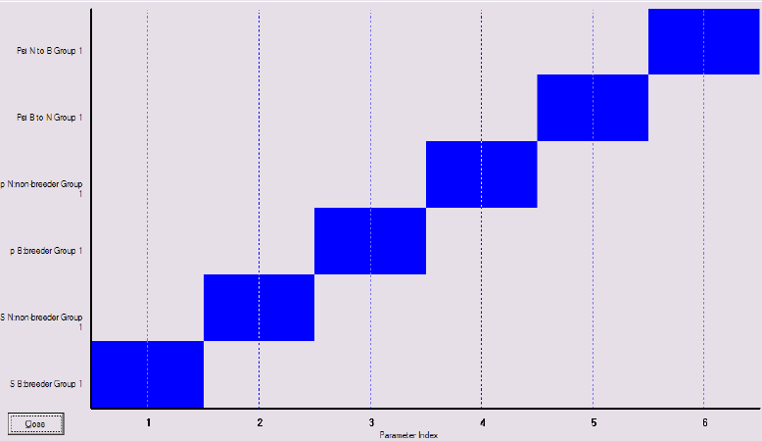
Deer Breeding – Simple Model Parameter Index Matrix (PIM)

Slide 25
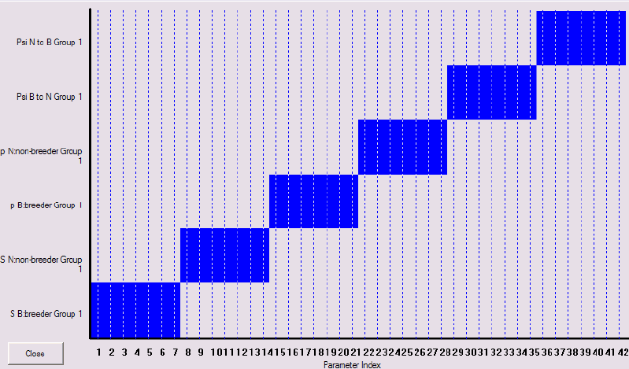
Deer Breeding – Complex Model Parameter Index Matrix (PIM)

Slide 26
Deer Breeding - Results
The simple (constant rates) model was better than the complex (time varying) model:

Slide 27
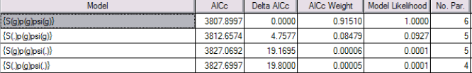
Deer Breeding – Model Refinement
Rates may not vary among breeders and non-breeders:

Slide 28
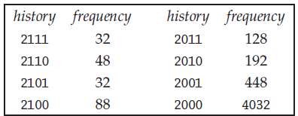
Recruitment and Breeding
Multi-state models can be used to model transition from non-breeder to breeder:
Birth is indicated as ‘2’ of a single cohort
Observed breeding (‘recruitment’) as ‘1’
The transition from juvenile to adult is a

Slide 29
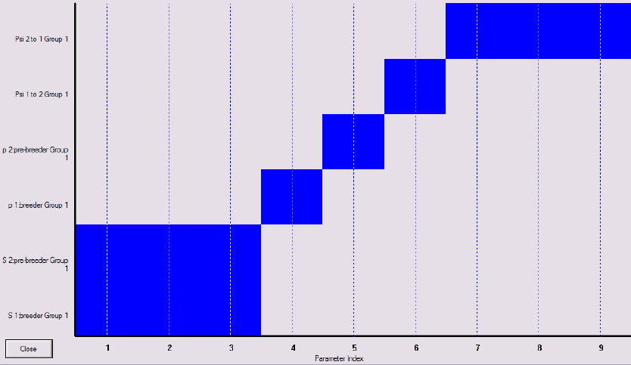
Recruitment and Breeding
Time varying survival and transition to breeding:

Slide 30
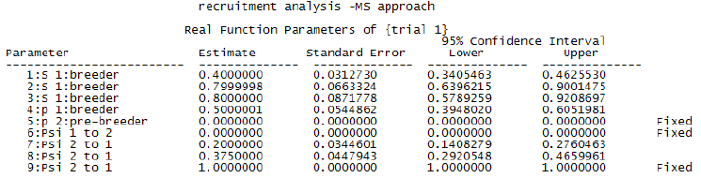
Recruitment and Breeding
Not all parameters are estimable, so some constraints are needed:
pre-breeder capture probability=0
No transition from breeder to non-breeder
All age-3 are breeders

Slide 31
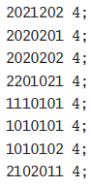
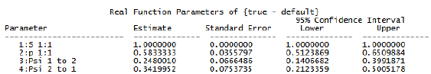
Estimation Problems
Multi-state models often have ‘local minima’ in -Log likelihood.
Simulation: 7 sampling occasions with 2 states with S = 1.0, p = 0.6, ψ¹² = 0.60, and ψ²¹ = 0.85.
Parameter estimates are wrong:

Slide 32
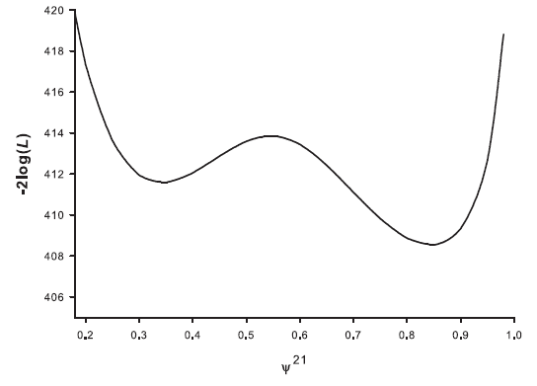
Estimation Problems
If we plot the deviance (–2 Log L) over a range of ψ²¹ values we see a local minimum at ~0.35 (true value = 0.85)

Slide 33
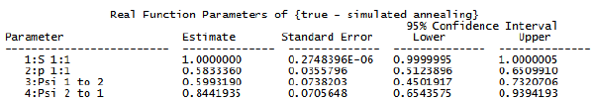
Robust Estimation
Simulated annealing involves ‘jumps’ to new parameter values in the numerical search. It adds computing time, but is robust to local minima:

Slide 34
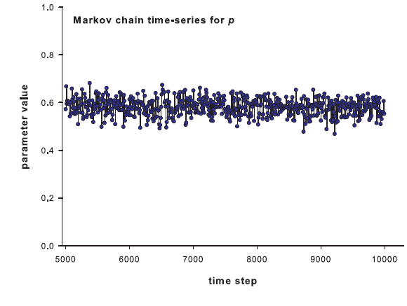
Markov Chain Monte Carlo
‘MCMC’ is a statistical algorithm that replicates a numerical solution with randomizations around the estimate and its standard error to approximate probability distributions of a parameter

Slide 35
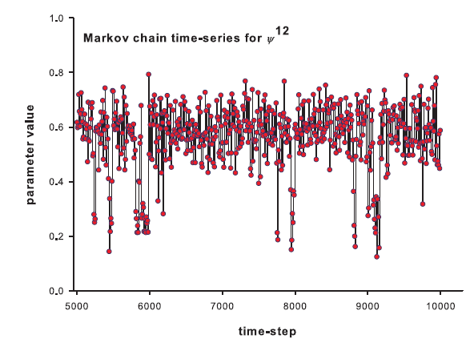
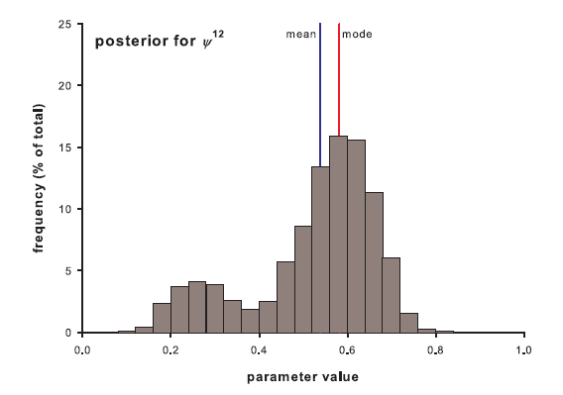
Posterior Distributions
Some parameters have multiple solutions and multimodal posterior distributions:

Slide 36
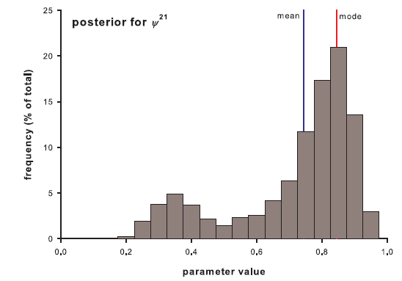
Posterior Distributions
MCMC reveals the same local minimum as the likelihood profile.

Slide 37
A Unifying Framework
Multi-strata modeling has the potential to be a common, unified ‘framework’ under which a large variety of models can be fit - including those combining information from multiple sources.
For example, a simple Cormack-Jolly-Seber model can be viewed as a 2-strata Z(alive or dead) with transition from live to dead:

Slide 38
A Unifying Framework
Simple mark-recapture or tag-recovery models assume homogeneous groups with no transition among groups.
Multi-state models allow transitions among groups:
Life history models (e.g., stage-based or age-based)
Movement among areas
Integrated demographic models with movement.
Single State or no transitions among ‘groups’
Life
History
Stages
Movement
Integrated
Models

Slide 39
Summary
Multi-state models include transition probabilities among alternate states:
Movement among distinct areas
Maturation from juvenile to adult
Transition from living to dead
Unfortunately, many rate processes (movement, mortality, maturation) are confounded, so models require constraints, robust estimation and diagnostics.
Multi-state models can be viewed as a unifying framework for modeling population processes (survival, growth, mortality, movement, etc.).

Slide 40
Lab 9 – Bird Migration
Data from Field Experiment (~Conroy 2015, Lab9.dat):
Birds are tagged on Island A.
Birds are sampled on Islands A, B and C over four months
Estimate time-invariant survival, capture, residence and movement rates (Lab9.tpl).
Evaluate alternative models.
Capture History | Frequency
A00 | 491
A0A | 15
A0B | 12
A0C | 11
AA0 | 37

Slide 41
Lab 9 – Bird Migration (Lab9.dat)
#######################
# MAR 580: Advanced Population Modeling
# Fall 2015
# Steve Cadrin & Gavin Fay
# Lab 9: multi-state mark-recapture
# encounter history A00
491
# encounter history A0A
15
# encounter history A0B
12
# encounter history A0C
11
# encounter history AA0
37
Capture History | Frequency
A00 | 491
A0A | 15
A0B | 12
A0C | 11
AA0 | 37

Slide 42
Lab 9 – Bird Migration (Lab9.tpl)
//////////////////////////////////////////////
// MAR 580: Advanced Population Modeling
// Fall 2015
// Steve Cadrin
// November 5, 2015
//
// Lab 8: Multi-State Mark Recapture
//////////////////////////////////////////////
DATA_SECTION
init_int A00; // frequency of encounter history
init_int A0A; // frequency of encounter history
init_int A0B; // frequency of encounter history
init_int A0C; // frequency of encounter history
init_int AA0; // frequency of encounter history

Slide 43
Lab 9 – Bird Migration (Lab9.tpl)
PARAMETER_SECTION
init_number logit_phi;
//estimating survival in logit space
init_number logit_p;
//estimating capture probability in logit space
init_number logit_psi;
//estimating movement from A probability in logit space
sdreport_number phi;
sdreport_number p;
sdreport_number psi;
number p_A00;
number p_A0A;
number p_A0B;
number p_A0C;
number p_AA0;
number exp_frq_A00;
number exp_frq_A0A;
number exp_frq_A0B;
number exp_frq_A0C;
number exp_frq_AA0
objective_function_value obj_fun;

Slide 44
Lab 9 – Bird Migration (Lab9.tpl)
PROCEDURE_SECTION
//transform the estimated params to the 'real' parameters
//cout << logit_phi << endl;
//cout << logit_p << endl;
//cout << logit_psi << endl;
phi = mfexp(logit_phi)/(1.+mfexp(logit_phi));
p = mfexp(logit_p)/(1.+mfexp(logit_p));
psi = mfexp(logit_psi)/(1.+mfexp(logit_psi));

Slide 45
Lab 9 – Bird Migration (Lab9.tpl)
// probabilities for each recapture history
p_A00 = 1-phi*p-phi*(1-p)*phi*p;
// probability of no recaptures
from simple mark-recapture with one state (see lab 2)
p_A0A = phi*(1-p)*phi*p*(psi*psi+(1-psi)*(1-psi));
// survived_t1 and not_captured_t2 and survived_t2 and captured_t3 and
((moved_t1 and moved_t2)or (stayed_t1 and stayed_t2)
p_A0B = phi*(1-p)*phi*p*(psi*(1-psi)+(1-psi)*(psi));
// survived_t1 and not_captured_t2 and survived_t2 and captured_t3 and
((moved_t1 and stayed_t2)or (stayed_t1 and moved_t2)
p_A0C = phi*(1-p)*phi*p*(psi*(1-psi)+(1-psi)*(psi));
// survived_t1 and not_captured_t2 and survived_t2 and captured_t3 and
((moved_t1 and stayed_t2)or (stayed_t1 and moved_t2)
p_AA0 = phi*psi*p*((1-phi)+(1-p));
// survived_t1 and stayed_t1 and captured_t2 and
(died_t2 or not_captured_t3)

Slide 46
Lab 9 – Bird Migration (Lab9.tpl)
//calculate the objective function
obj_fun = -A00*log(p_A00)-A0A*log(p_A0A)-A0B*log(p_A0B)-A0C*log(p_A0C)-AA0*log(p_AA0);
exp_frq_A00=p_A00*(A00+A0A+A0B+A0C+AA0);
exp_frq_A0A=p_A0A*(A00+A0A+A0B+A0C+AA0);
exp_frq_A0B=p_A0B*(A00+A0A+A0B+A0C+AA0);
exp_frq_A0C=p_A0C*(A00+A0A+A0B+A0C+AA0);
exp_frq_AA0=p_AA0*(A00+A0A+A0B+A0C+AA0);

Slide 47
Lab 9 – Bird Migration (Lab9.tpl)
REPORT_SECTION
report << "phi" << endl;
report << phi << endl;
report << "p" << endl;
report << p << endl;
report << "psi" << endl;
report << psi << endl;
report << "expected frequency A00" << endl;
report << exp_frq_A00 << endl;
report << "expected frequency A0A" << endl;
report << exp_frq_A0A << endl;
report << "expected frequency A0B" << endl;
report << exp_frq_A0B << endl;
report << "expected frequency A0C" << endl;
report << exp_frq_A0C << endl;
report << "expected frequency AA0" << endl;
report << exp_frq_AA0 << endl;
);

Slide 48
Lab 9 – Bird Migration (Lab9.rep)
phi 0.634068
p 0.125566
psi 0.776051
probability of A00 0.876238
probability of A0A 0.0287999
probability of A0B 0.0153441
probability of A0C 0.0153441
probability of AA0 0.0766388
expected frequency A00 495.951
expected frequency A0A 16.3008
expected frequency A0B 8.68474
expected frequency A0C 8.68474
expected frequency AA0 43.3776
Capture History | Frequency
A00 | 491
A0A | 15
A0B | 12
A0C | 11
AA0 | 37

Slide 49
Lab 9 – Bird Migration (Lab9.cor)
The logarithm of the determinant of the hessian = 8.86743
name value std.dev 1 2 3 4 5
logit_phi 5.4971e-001 3.5924e-001 1.0000
logit_p -1.9407e+000 2.3492e-001 -0.8341 1.0000
logit_psi 1.2428e+000 2.5498e-001 -0.0000 0.0000 1.0000
phi 6.3407e-001 8.3353e-002 1.0000 -0.8341 -0.0000 1.0000
p 1.2557e-001 2.5794e-002 -0.8341 1.0000 0.0000 -0.8341 1.0000
psi 7.7605e-001 4.4314e-002 -0.0000 0.0000 1.0000 -0.0000 0.0000

Slide 50
Lab 9 – Bird Migration
Evaluate alternative models.
Area-specific movement rates, survival rates?
Time-varying rates?
Hints
Encounter history probabilities will need to be revised, but the structure of the probabilities will be the same.
Check the probability values (sum to <1, allowing for non-observed encounter histories))
Capture History | Frequency
A00 | 491
A0A | 15
A0B | 12
A0C | 11
AA0 | 37

Slide 51
Where Are We Going?
Next Lecture – Bayesian Methods (Punt & Hilborn 1997)

